Slide 1






Machine Learning 1
March 10th, 2026
Predicting Clothing Fit
A Machine Learning Approach to Size Recommendation
Harleen Kaur Buttar
Dora Jiayue Li
Skylar Liu

Slide 2







Business Problem
Product size recommendation and fit prediction improve online shopping and reduce returns.
This project builds a machine learning pipeline that identifies body-type segments, predicts fit outcomes (Small / Fit / Large), and recommends optimal sizes for customer–product pairs.
Notes:
SKYLAR Product size recommendation and fit prediction are critical to improving online shopping experiences and reducing return rates. Customers frequently receive ill-fitting clothing because standard sizing fails to account for variation in body types, brand-specific sizing conventions, and subjective fit preferences. We built an end-to-end machine learning pipeline that discovers latent body-type segments, predicts fit outcomes (Small / Fit / Large), and recommends optimal sizes for new customer–product pairs.

Slide 3








Analytical Plan
Expected Results: A recommendation pipeline that will take in body measurements and return sizes of items
Phase 1
Phase 2
Phase 3
Discover latent structure in customer body types, product categories, and review language.
Predict fit outcome (Small / Fit / Large) as a multiclass classification problem with imbalanced labels.
Prescriptive system that recommends the size most likely to produce a "Fit" outcome for a new customer–product pair.
Notes:
SKYLAR

Slide 4




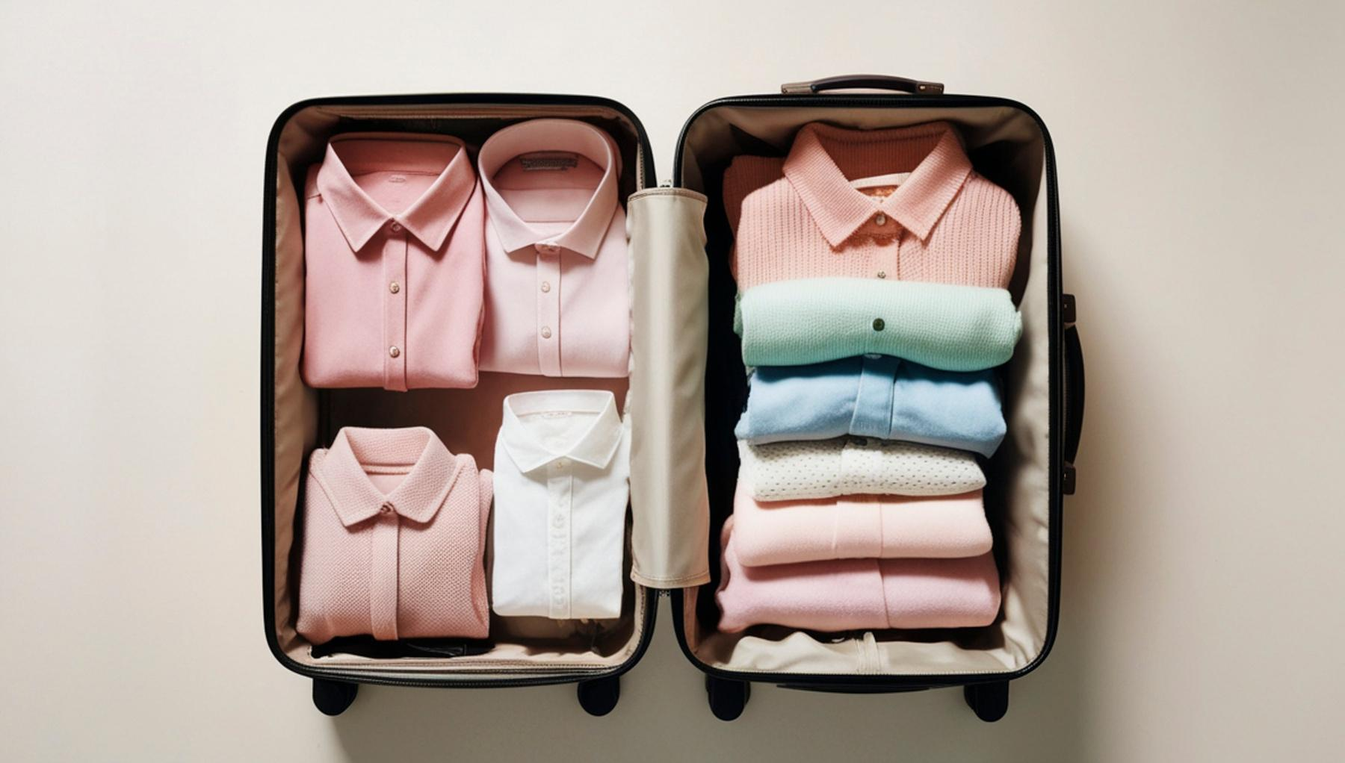



Downloading The Data
The datasets were downloaded from Kaggle using the KaggleHub API and stored in the Data/Raw directory for preprocessing and analysis.
Rent The Runway (RTR)
192,544 rental transactions with detailed fit feedback, body measurements, review text, ratings, and occasion context, making it the primary dataset for modeling clothing size recommendations.
ModCloth
82,790 purchase transactions with fit feedback, partial body measurements, and review data, used as a secondary dataset to evaluate cross-retailer generalization of the size recommendation models.
Data Description
Clothes-Size-Prediction
119,218 records with clean height, weight, and age features mapped to clothing sizes (XXS–XXXL), used as a baseline dataset for benchmarking classifier performance.
Notes:
SKYLAR

Slide 5
Downloading The Data
Standardized body measurements by converting height, weight, and bust size into numeric features and computing BMI.
One-hot encoded categorical variables (fit feedback, body type, rental occasion, length feedback) into numeric labels for modeling.
ModCloth
Removed high-null columns (>80%), dropped rows with missing target labels, and standardized column names and formats.
Clothes-Size-Prediction
Data Cleaning
Filtered unrealistic age, height, and weight values and converted them into same units (inches + pounds), keep features consistent across datasets for modeling.
Notes:
Converted the units consistently into inches and pounds (sizing data)
Converted the breast size into bust band + cup size (numerical)

Slide 6






Phase 1: Unsupervised Models
Clustering
K-modes
DBSCAN
K-means
GMM
Review based segment
LDA
Through the clustering we aim to find dimensions of why fit fails, especially understand who the customers are and what they are renting.
LDA translated unstructured customer language into structured probability distributions that could be encoded into the Phase II classifier as features.
Notes:
Predicting clothing fit requires understanding two distinct but equally important dimensions of why fit fails: who the customer is and what they are renting.
In phase I, after basic Exploratory Data Analysis, we dive deeper into finding the realistic dimensions that differentiate one size from another, understand who the customers are and what they are renting (garment context) through clustering. We also incorporate LDA to understand customers subjective experiences through the reviews. Together they transform raw data into the complete feature space needed to predict whether a piece of cloth will fit before a customer ever tries it on.

Slide 7














Clustering Methodology
No cluster count assumed
Features engineered specifically for each method
Numeric and categorical structure modeled separately
DBSCAN finds dense regions naturally, while GMM selects k via BIC/AIC.
K-Means and K-Modes used elbow plots to let the data guide selection.
Numeric features were standardized for distance-based methods;
categorical features were isolated for K-Modes.
Feature selection was tailored to the assumptions of each algorithm rather than using a one-size-fits-all input.
K-Means, GMM, and DBSCAN operate on continuous body measurements;
K-Modes operates on categorical features like garment type and rental occasion.
Using both captures multidimensional customer behavior
Notes:
Body measurements form continuous, overlapping segments — not discrete groups. Across all clustering methods, no sharp boundaries emerged between body types. Most customers fall within a broad continuum, which is precisely why fixed sizing systems fail — and why soft assignments (GMM confidence scores, DBSCAN outlier flags) are more informative than hard labels alone.
Categorical context matters as much as physical measurements. K-Modes revealed that fit complaints cluster around specific combinations of garment category, body type, and rental occasion — patterns invisible to numeric clustering. A customer's fit outcome is shaped by what they're renting and why, not just their measurements.
A meaningful minority of customers are consistently mis-served. Every clustering method surfaced a subset of users whose body profiles sit outside the mainstream — DBSCAN's noise points, GMM's low-confidence assignments, and K-Means' smallest clusters all point to the same population. These are the customers most likely to report poor fit, and the highest-value targets for personalized sizing recommendations.

Slide 8



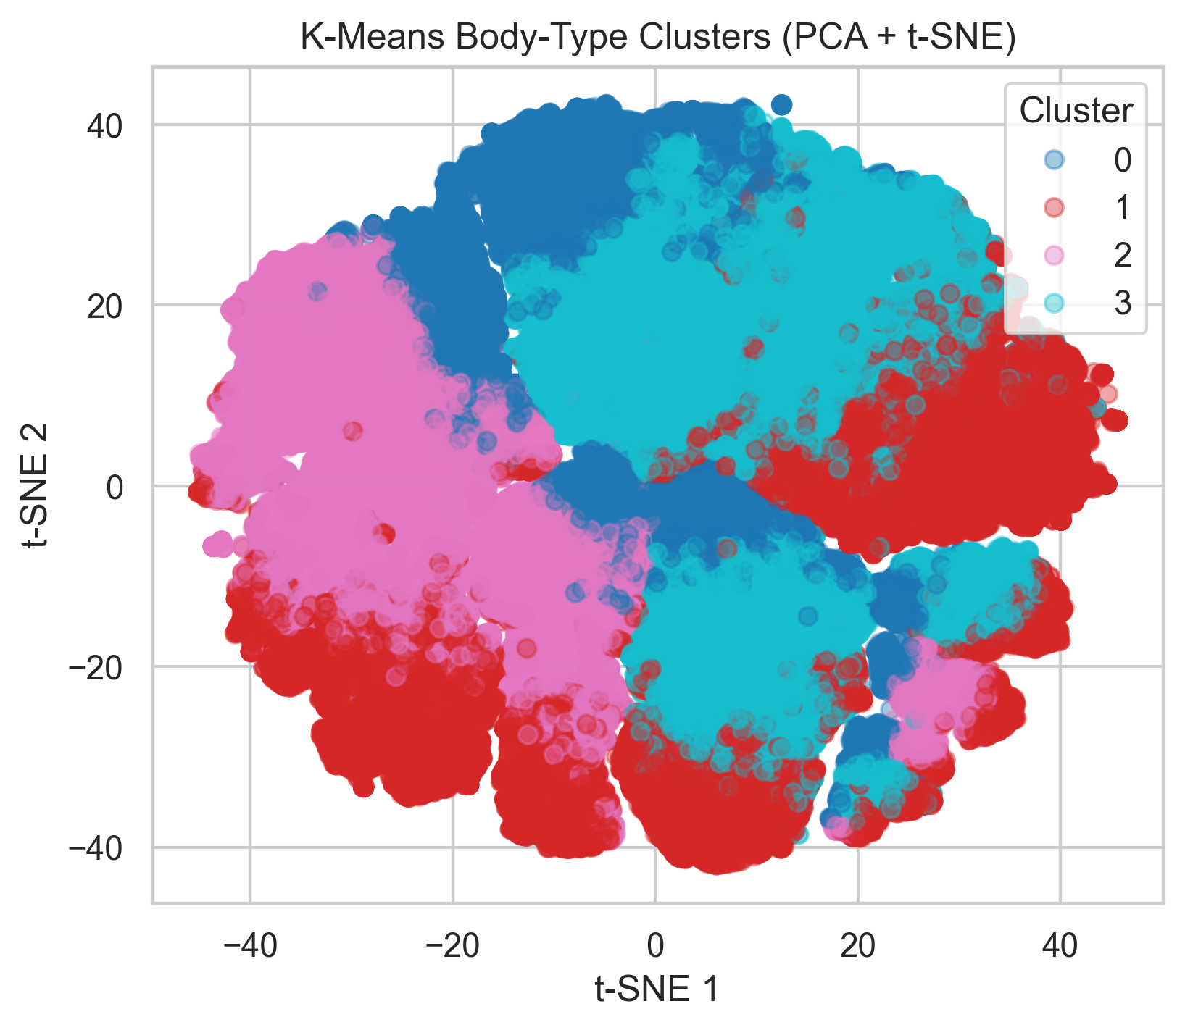



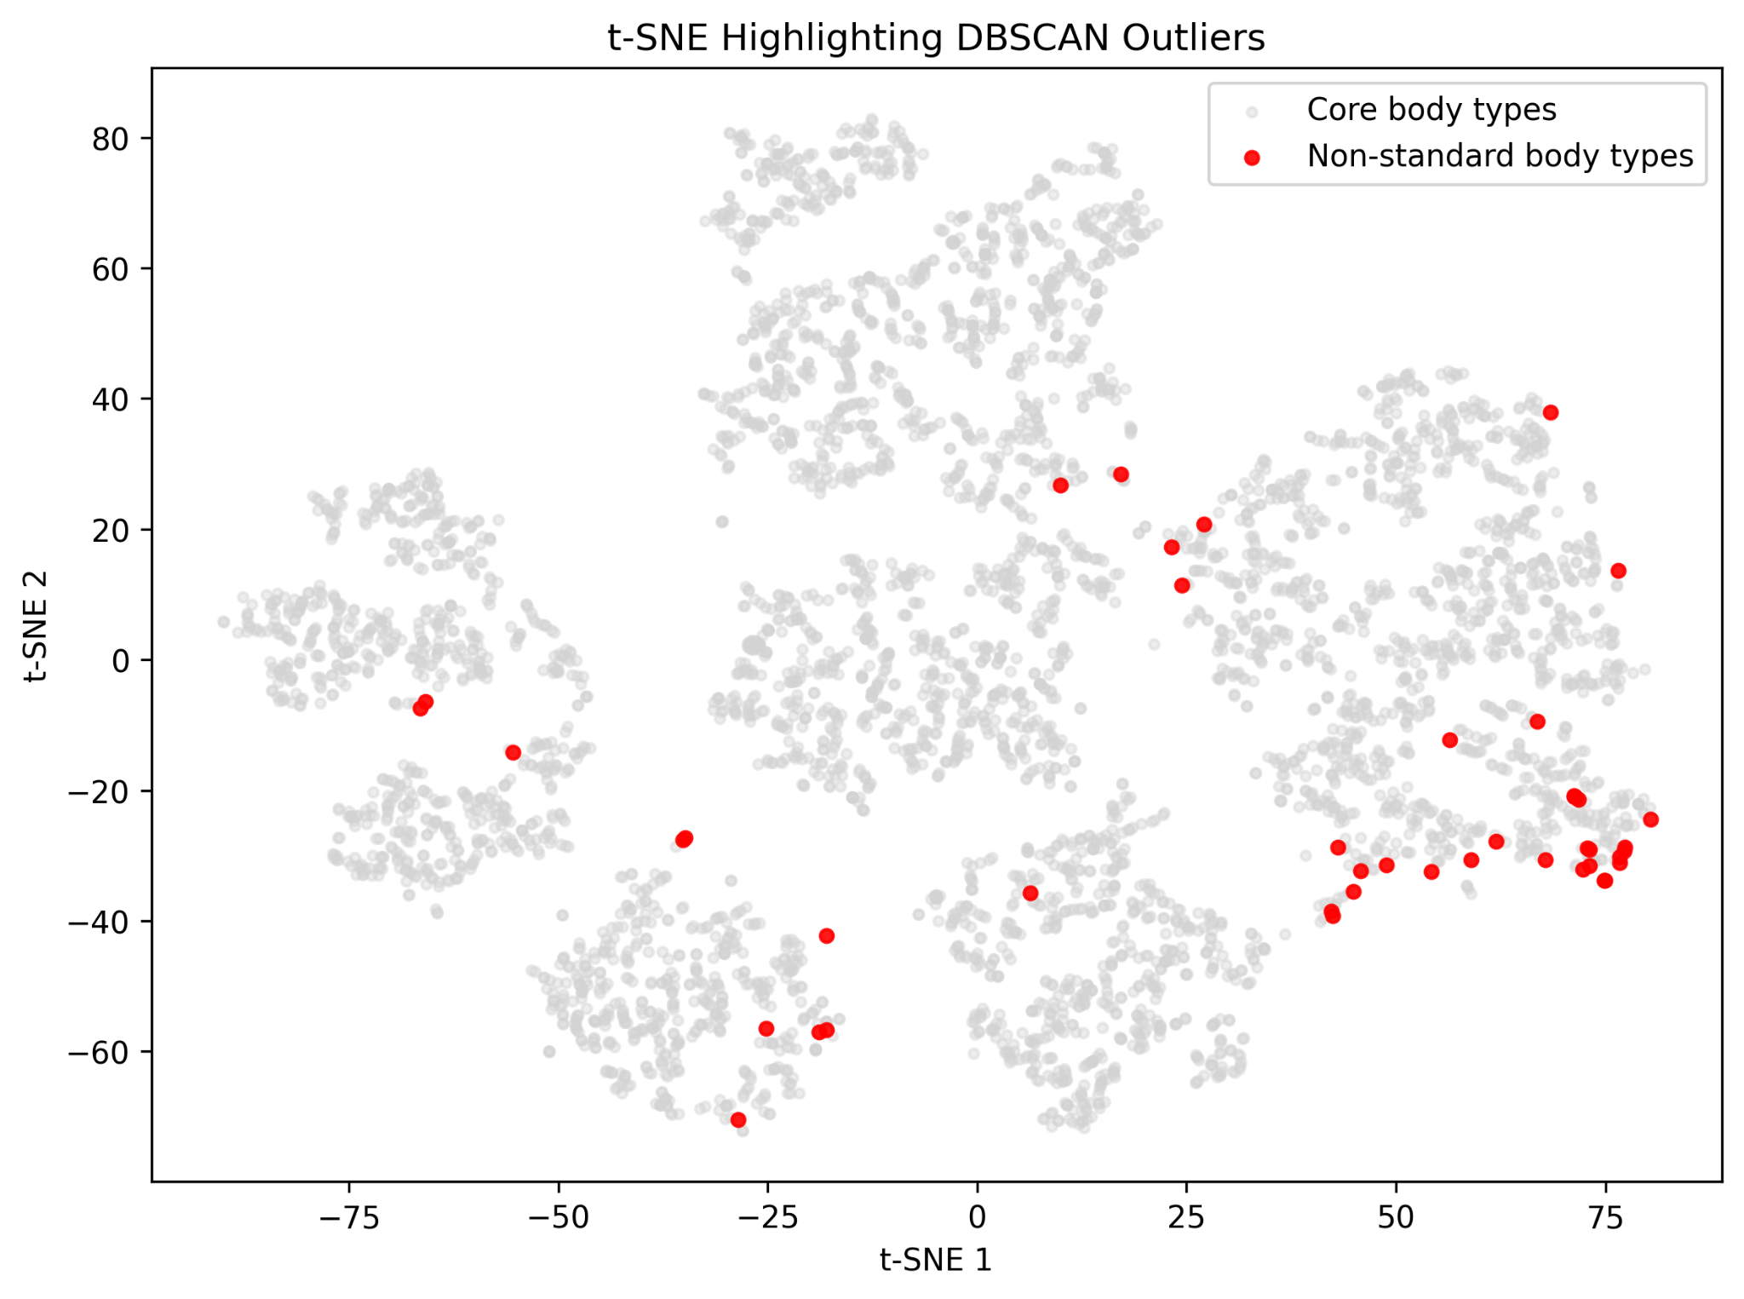

Borcelle Studio
Clustering Overview
Clustering uncovered latent structure in body profiles and fit feedback in the RentTheRunway dataset. DBSCAN, K-Means, and GMM segmented users based on body measurements, while K-Modes captured patterns in categorical variables like fit outcome, clothing category, and occasion, revealing how body characteristics and rental context relate to fit outcomes.
Notes:
Clustering was used to uncover latent structure in body profiles and fit feedback in the RentTheRunway dataset. DBSCAN identified dense regions of similar body measurements and flagged outliers, while K-Means segmented users based on standardized body measurements. A Gaussian Mixture Model (GMM) captured overlapping body-type distributions through probabilistic clusters, and K-Modes segmented categorical rental patterns such as fit outcome, clothing category, and occasion. Together, these methods reveal how body characteristics and rental context relate to clothing fit outcomes.

Slide 9

LDA Methodology
Text Preprocessing
LDA Topic Modeling
Topic Selection and Feature Extraction
Smart Selection
Review text was cleaned and normalized by converting all text to lowercase, removing punctuation and stopwords, and applying lemmatization.
Domain-specific stopwords related to clothing and rentals were also removed to reduce noise and improve topic quality.
Latent Dirichlet Allocation (LDA) was applied to the processed reviews using a bag-of-words representation.
Multiple models were trained with different numbers of topics, and topic coherence (c_v) was used to evaluate and compare model quality.
The model with the highest coherence score (k = 11 topics) was selected as the final model.
Topic probability distributions and dominant topics were extracted for each review and used as additional features for downstream predictive models.
Notes:
1. Text Preprocessing and Tokenization Customer review text from the RentTheRunway dataset was cleaned and normalized by converting text to lowercase, removing punctuation and stopwords, and applying lemmatization. Domain-specific stopwords (e.g., “dress”, “rent”, “size”) were also removed to reduce noise and ensure the LDA model focused on meaningful semantic signals in the reviews.
2. Topic Modeling with LDA Latent Dirichlet Allocation (LDA) was applied to the processed review corpus using the Gensim library. A bag-of-words representation was constructed from a filtered dictionary that removed extremely rare and overly common tokens. Multiple models were trained with different numbers of topics, and topic coherence (c_v) was used to evaluate model quality.
3. Topic Selection and Feature Generation The optimal number of topics was selected based on the highest coherence score (k = 11). The final LDA model produced topic probability distributions for each review, and the dominant topic and topic proportions were extracted. These topic distributions were then used as additional features for downstream classification models predicting clothing fit outcomes.

Slide 10

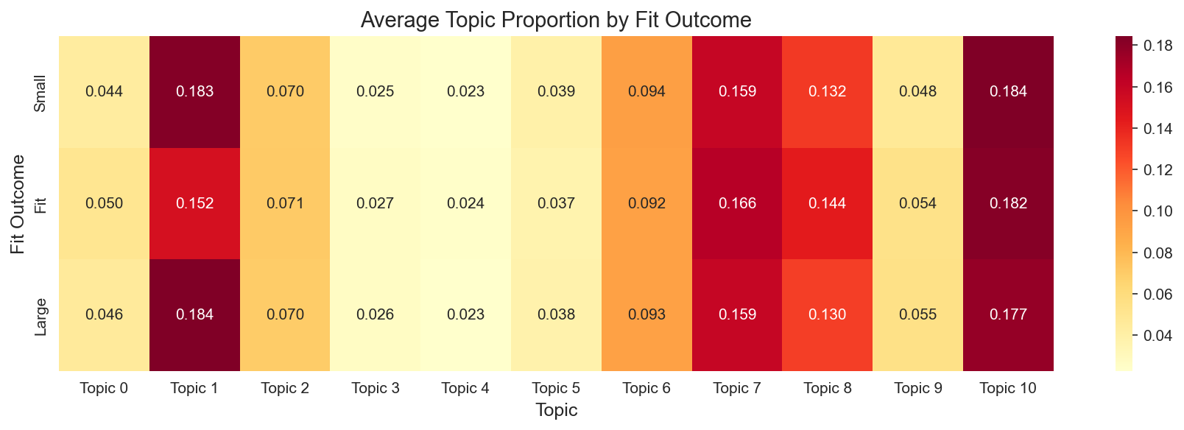
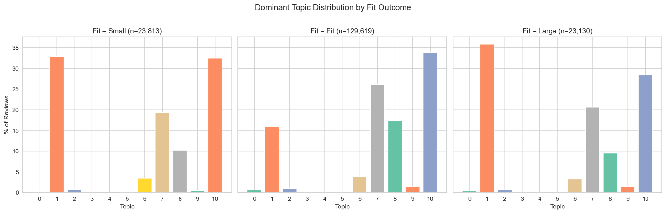
LDA Overview
LDA identified 11 meaningful topics in RentTheRunway reviews related to sizing, fabric, styling, and rental experiences.
Reviews labeled “Small” or “Large” contained more sizing-related language, while “Fit” reviews emphasized positive experiences, indicating that topic patterns capture useful signals for predicting clothing fit.
Notes:
LDA topic modeling on 176,562 RentTheRunway reviews identified 11 coherent themes related to garment fit, construction, styling, occasions, and user experiences. Topics related to sizing feedback, fabric and construction, and undergarment structure were the most prevalent across reviews. Reviews labeled as “Small” or “Large” showed higher proportions of the sizing discussion topic, while reviews labeled “Fit” contained more positive social experience language, suggesting that topic distributions capture meaningful signals related to perceived fit. These topic probabilities were incorporated as additional features for downstream fit prediction models.

Slide 11

Phase 2: Supervised Models
Bagging
CART
Kernel SVM
KNN
Linear SVM
Naive Bayes
Random Forest
These seven models were chosen because fit prediction is driven by a mix of continuous measurements, categorical features, and probabilistic text signals. We ran multiple models to ensure the pipeline captures every dimension of the problem. Cross-validating all seven then allows the best-performing model to be selected with confidence, giving the business a reliable, generalizable tool for telling customers whether clothes will fit.
Notes:
SKYLAR
These seven models were chosen because fit prediction is driven by a mix of continuous measurements, categorical garment features, and probabilistic text signals — and no single algorithm handles all of these input types equally well, so running multiple model families ensures the pipeline captures every dimension of the problem. Cross-validating all seven then allows the best-performing model to be selected with confidence, giving the business a reliable, generalizable tool for telling customers whether a garment will fit before it ever ships.

Slide 12
Models Methodology
Feature Engineering
Model Training
Model Evaluation
Smart Selection
Body measurements were combined with cluster features from DBSCAN, GMM, and K-Means and topic features from LDA.
Numeric variables were imputed and standardized, cluster features were one-hot encoded, and a DBSCAN outlier indicator was included.
Models were implemented using scikit-learn pipelines that integrate preprocessing and model estimation.
Hyperparameters were tuned using GridSearchCV with five-fold stratified cross-validation, using macro F1-score to account for class imbalance across the three fit categories.
The best model from cross-validation was evaluated on a held-out test set.
Performance was assessed using classification reports and confusion matrices, and predicted class probabilities were saved to analyze model confidence and fit prediction behavior.
Notes:
SKYLAR
Blurb 1 — Feature Engineering and Data Integration
To model garment fit outcomes (Small, Fit, Large), we constructed a feature set that combines raw body measurements with information derived from earlier unsupervised analyses. The base dataset was enriched with cluster assignments from DBSCAN, Gaussian Mixture Models, and K-Means, along with topic features extracted from LDA applied to review text. Numeric variables were imputed using median values and standardized, while cluster-based features were treated as categorical variables and encoded using one-hot encoding. Binary indicators such as DBSCAN outlier status were also included. These transformations were implemented through a unified preprocessing pipeline using a ColumnTransformer, ensuring consistent feature preparation across models.
Blurb 2 — Model Training Framework
All models were implemented using scikit-learn pipelines that combine preprocessing and model estimation into a single workflow. This structure ensures that data transformations are applied consistently within each fold of cross-validation and prevents information leakage between training and validation data. Hyperparameters were tuned using GridSearchCV with five-fold stratified cross-validation, using macro F1-score as the evaluation metric to account for class imbalance across the three fit categories.
Blurb 3 — Evaluation and Prediction Outputs
After hyperparameter tuning, the best-performing configuration from cross-validation was retrained on the full training set and evaluated on a held-out test set. Model performance was assessed using classification reports and confusion matrices to evaluate prediction accuracy across the Small, Fit, and Large classes. In addition to discrete predictions, class probabilities were generated for each observation, allowing downstream analysis of prediction confidence and model behavior across different body profiles.

Slide 13
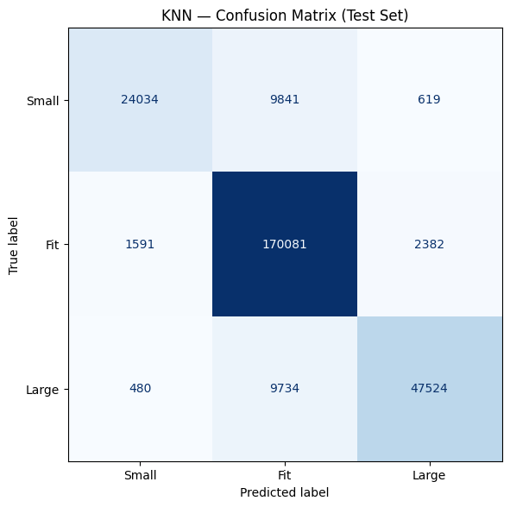

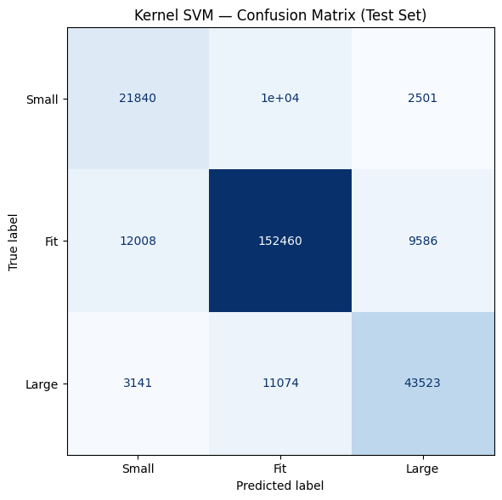
Borcelle Studio
Modeling Overview
Multiple models were tested to predict fit outcomes (Small, Fit, Large) using body measurements, clustering, and topic features.
Nonlinear models performed best: Kernel SVM reached 82% accuracy and KNN achieved the highest performance at 91% accuracy (0.90 F1), while tree models performed moderately and Linear SVM and Naive Bayes struggled due to class imbalance and model assumptions.
Notes:
SKYLAR
Multiple classification models were evaluated to predict garment fit outcomes (Small, Fit, Large) using body measurements, clustering features, and topic features. Tree-based models (CART, Bagging, Random Forest) achieved 73–77% accuracy but struggled with the minority Small class due to class imbalance. Kernel SVM improved performance to 82% accuracy, while KNN delivered the best results with 91% accuracy and 0.90 weighted F1. In contrast, Linear SVM largely defaulted to the majority Fit class, and Naive Bayes underperformed due to violated independence assumptions. Overall, non-linear models such as Kernel SVM and KNN performed best for predicting clothing fit.

Slide 14

Model Comparison Methodology
Feature Engineering
Model Training
Model Evaluation
Smart Selection
Two datasets were used: a simple dataset with basic features (weight, age, height) and a rich RTR dataset with engineered features.
The simple dataset was split into 80/20 stratified train/test sets, while RTR predictions were reconstructed from saved model probabilities.
Seven classifiers were trained using scikit-learn pipelines and GridSearchCV with 5-fold stratified cross-validation, optimizing macro-F1.
Models were compared using accuracy and macro-F1, and results from both datasets were merged to evaluate how richer features affected performance.
Notes:
Data Preparation and Feature Sets Two datasets were used for the comparison: a simple baseline dataset containing three basic demographic features (weight, age, and height) and a rich feature dataset derived from the RentTheRunway (RTR) data containing engineered and contextual variables. For the simple dataset, rows with missing values were removed and the target variable representing clothing fit (Small, Fit, Large) was encoded numerically. The dataset was then split into training and test sets using stratified sampling (80/20 split) to preserve class proportions. For the RTR dataset, previously generated model probability outputs were loaded and converted into predicted classes by selecting the class with the highest predicted probability.
Model Training and Hyperparameter Optimization Seven classification algorithms were evaluated: Linear SVM, Kernel SVM, CART decision tree, Random Forest, Bagging, KNN, and Naive Bayes. For the simple dataset, each model was implemented within a scikit-learn pipeline that included preprocessing steps such as median imputation and feature scaling where appropriate. Hyperparameters were tuned using GridSearchCV with 5-fold stratified cross-validation, optimizing for macro-F1 score to ensure balanced performance across the three classes. To reduce computational cost, Kernel SVM was trained on a 20,000-row subset of the training data during hyperparameter tuning.
Evaluation and Comparative Analysis After training, the best model from each grid search was evaluated on the held-out test set using accuracy and macro-F1 score, along with per-class F1 scores for Small, Fit, and Large categories. For the RTR models, predictions were reconstructed from stored probability outputs and evaluated using the same metrics to ensure consistency. Results from both datasets were merged into a single comparison table, and the performance differences (Δ Accuracy and Δ Macro-F1) were calculated to quantify the impact of the richer feature set. Visualizations were then generated to compare model performance, highlight macro-F1 improvements, and analyze per-class predictive performance.

Slide 15

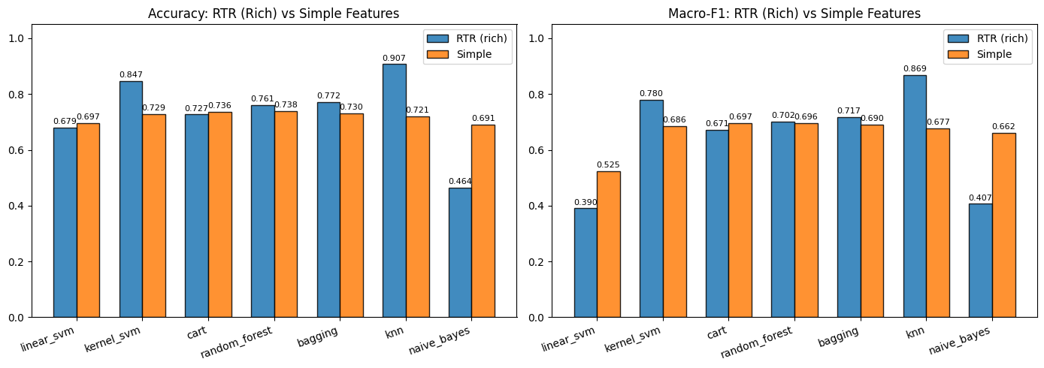
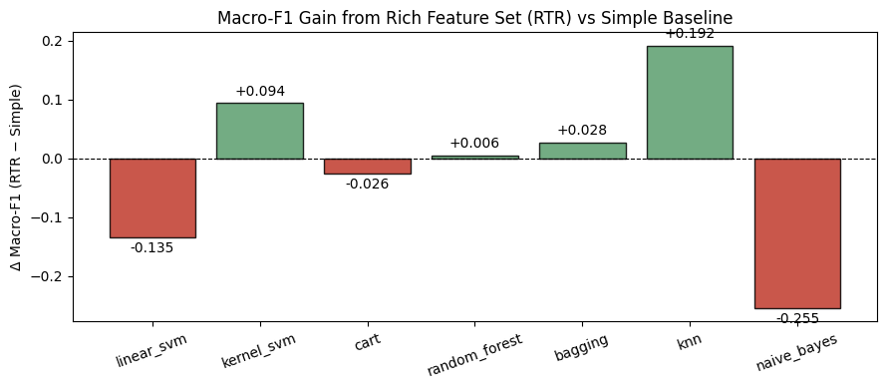
Model Comparison Overview
The RTR rich feature set improves performance for several models, especially KNN, whose macro-F1 increases from 0.677 to 0.869 and accuracy from 72.1% to 90.7%.
Kernel SVM and ensemble models show smaller gains, while Linear SVM, CART, and Naive Bayes perform worse with the richer features. Overall, models that capture nonlinear relationships benefit most from the richer dataset.
Notes:
Comparing models trained on the rich RTR feature set with those trained on the simple baseline features reveals that richer feature engineering benefits some algorithms substantially while hurting others. The largest improvement occurs with KNN, whose macro-F1 increases from 0.677 to 0.869 and accuracy rises from 72.1% to 90.7%, indicating that the richer representation captures meaningful similarity structure that distance-based models can exploit. Kernel SVM also improves notably (macro-F1 0.686 → 0.780), while ensemble models such as Random Forest and Bagging see smaller but consistent gains. In contrast, Linear SVM, CART, and especially Naive Bayes perform worse with the richer features, likely because the expanded feature space introduces correlations and nonlinear interactions that these models cannot effectively capture. Overall, the results suggest that the RTR rich feature set provides significant predictive value when paired with models capable of modeling nonlinear relationships, with KNN emerging as the strongest overall performer.

Slide 16

Phase 3: Ensemble Model Recommender
Goal: Recommend the most likely clothing size for a user given a product category (e.g., dress, top) using historical fit data.
Inputs: User body measurements (height, weight, age, bust band, cup size), product category, and ensemble model probabilities for fit outcomes.
Evaluation: Measure performance using Hit@1 and Hit@3, indicating whether the true worn size appears in the top recommended sizes.

Slide 17

Recommender Methodology
Collaborative Filtering
Similarity-Based Scoring
Popularity and Cold-Start Handling
The recommender uses collaborative filtering based on historical fit data.
A sparse user–item matrix is created where rows represent users and columns represent category–size pairs, with each entry storing the probability that the size fits the user.
Cosine similarity is used to identify users with similar fit patterns.
For a recommendation request, the system finds the most similar users and aggregates their fit probabilities for each candidate size within the category.
A similarity weighted average ensures that more similar users contribute more strongly to the predicted score.
A category-level size popularity prior is added to stabilize predictions when interaction data is sparse.
For new users without history, the system finds the closest user based on body measurements and uses that user’s profile to generate recommendations.
Notes:
Collaborative Filtering Framework The recommender system is built using a collaborative filtering approach that leverages historical interactions between users and clothing sizes. A sparse user–item matrix is constructed where rows represent users and columns represent category–size combinations (e.g., dress–8, top–4). Each cell stores the estimated probability that a given size fits the user, derived from the ensemble model predictions. Cosine similarity is then used to measure similarity between users based on their fit behavior across these category–size interactions, allowing the system to identify the most relevant neighbors for a given query.
Similarity-Based Size Prediction For a recommendation request, the system identifies the most similar users (top-k neighbors) and aggregates their fit probabilities for each candidate size within the requested product category. Rather than using a simple average, the model applies a similarity-weighted aggregation so that more similar users contribute more heavily to the predicted fit probability. This produces a score representing how likely each size is to fit the target user, based on patterns observed among users with similar body measurements and fit histories.
Popularity Prior and Cold-Start Handling To improve robustness when historical interactions are sparse, the recommender incorporates a category-specific size popularity prior, which captures the overall frequency of each size being chosen within a category. This prior is combined with the similarity-based score to stabilize predictions and prevent extreme recommendations from small neighbor sets. For new users without prior purchase history, the system performs cold-start matching by identifying the training user with the most similar body measurements (height, weight, age, bust band, cup size) and using that user’s interaction profile as a proxy for generating recommendations.

Slide 18




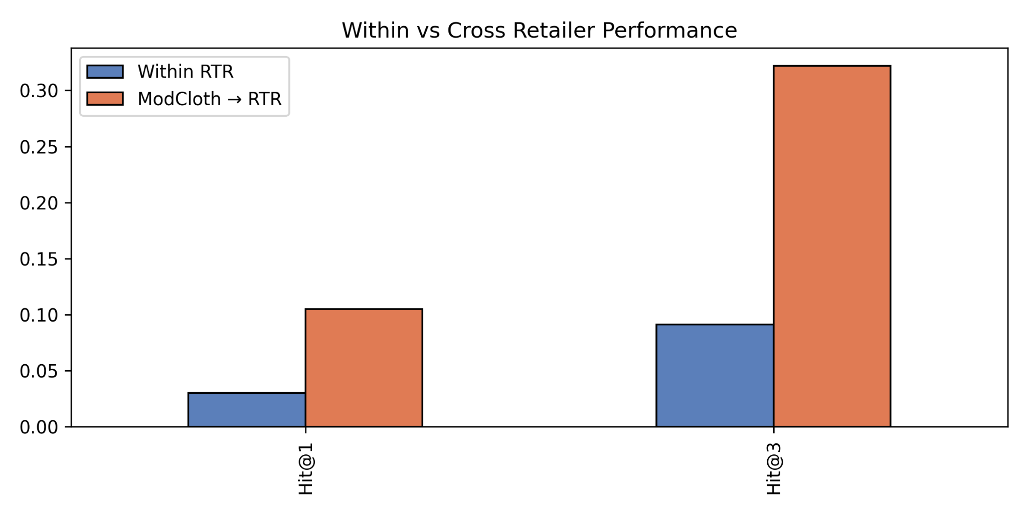
Recommender Results
Within RentTheRunway, performance is lower (Hit@1 = 3.0%, Hit@3 = 9.1%) due to data sparsity and unseen users.
The cross-retailer model trained on ModCloth performs better (Hit@1 ≈ 10.5%, Hit@3 ≈ 32.2%) because normalized categories allow size patterns to transfer across retailers.
Notes:
Within RentTheRunway, the recommender achieves lower performance (Hit@1 = 3.0%, Hit@3 = 9.1%) due to data sparsity and the user-level split, which requires predictions for unseen users. In contrast, the cross-retailer model trained on ModCloth performs better (Hit@1 ≈ 10.5%, Hit@3 ≈ 32.2%) because normalized product categories allow broader size patterns to transfer across retailers despite different item IDs.

Slide 19





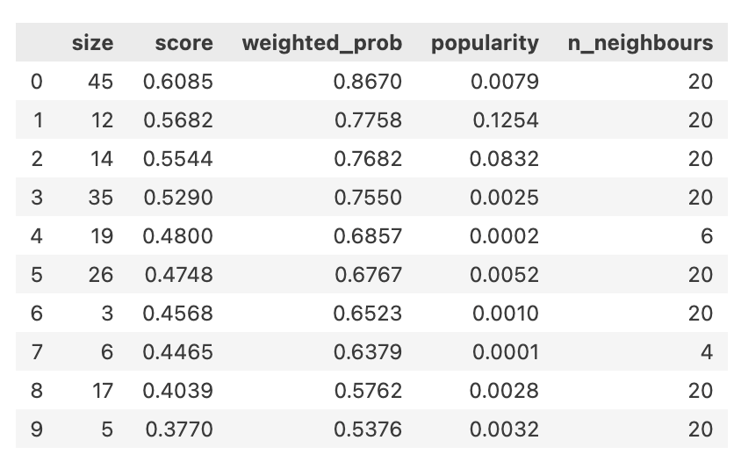
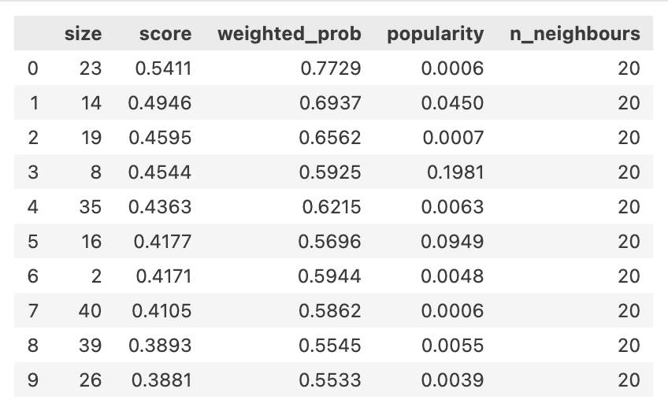

Recommender Output
Warm-Start Demo
Actual Size =14
Cold-Start Demo
Structured Smart
Weekend Relaxed
Soft pieces supporting movement and calm outdoor moments.

Slide 20

Limitations
Linear SVM
Naive Bayes
Random Forest
Data Limitations
Reviews are self-reported, fit labels reflect subjective perception, not objective measurement
Size inconsistency from one manufacturer to the next
Missing clothing dimensions
Modeling Limitations
No temporal dimension: does not account for how fit perception may change over time/seasons
KNN, Kernel SVM, Linear SVM, and Naive Bayes tuned on subsample
Recommender Limitations
Subpar performance on the RTR dataset due to it being trained on normalized categories instead of item_ids
Wide variety of sizes recommended due to lack of size consistency
Scope Limitations
Analysis is limited to women’s clothing and does not take different builds into account
Specifically Rent the Runway

Slide 21





Code Repository

Slide 22
Thank You!

Slide 23









Resource
Page
The resources included in this presentation. Feel free to explore or customize these assets to fit your theme and style better.

Slide 24










Resource
Page
The resources included in this presentation. Feel free to explore or customize these assets to fit your theme and style better.

